Slide 1

Air Sensing & Weather Monitoring System

Slide 2

Research and Documents

Slide 3
AQI - AIR QUALITY INDEX
Sources: https://www.cpcb.nic.in/National-Air-Quality-index/
https://www.airnow.gov/aqi/aqi-basics/

Slide 4
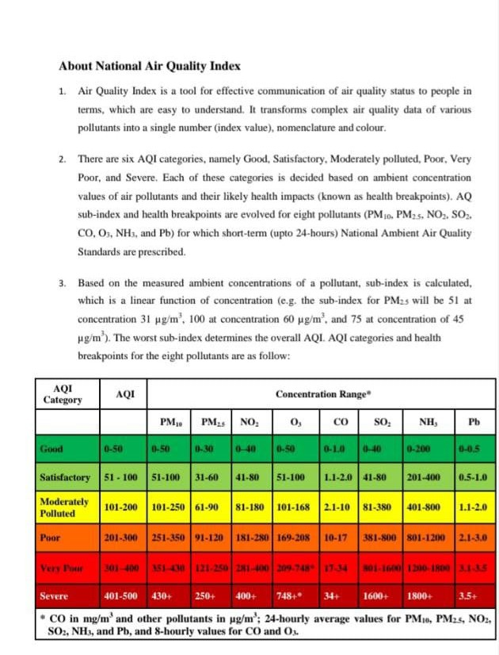
FROM CPCB – CENTRAL POLLUTION CONTROL BOARD

Slide 5
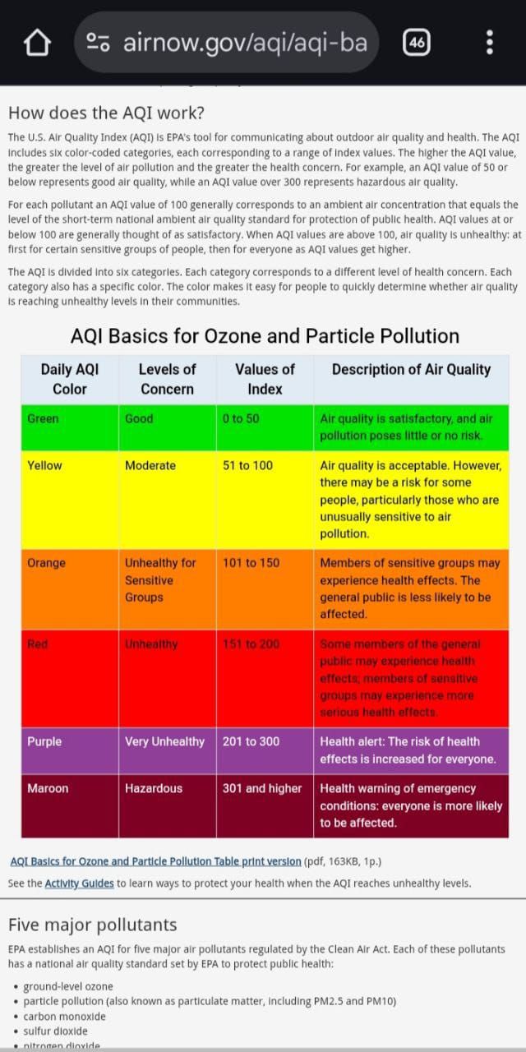
FROM AIRNOW – US GOVERNMENT

Slide 6
PARAMETERS CONSIDERED FOR AQI –
FROM CPCB: FROM AIRNOW US:
-PM 2.5 -Ground level O3
-PM10 -PM(2.5 and 10)
-NO2 -CO
-SO2 -SO2
-CO -NO2
-O3
-NH3
-Pb
All the eight pollutants may not be monitored at all the locations, overall AQI is calculated only if data are available
for minimum three
Pollutants out of which one should be either PM2.5 or PM10.
-From CPCB website

Slide 7
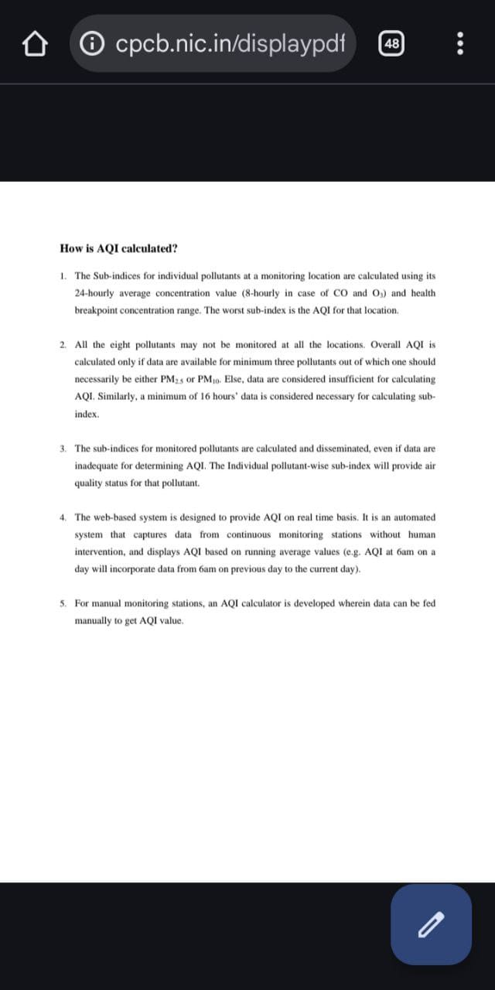

Slide 8
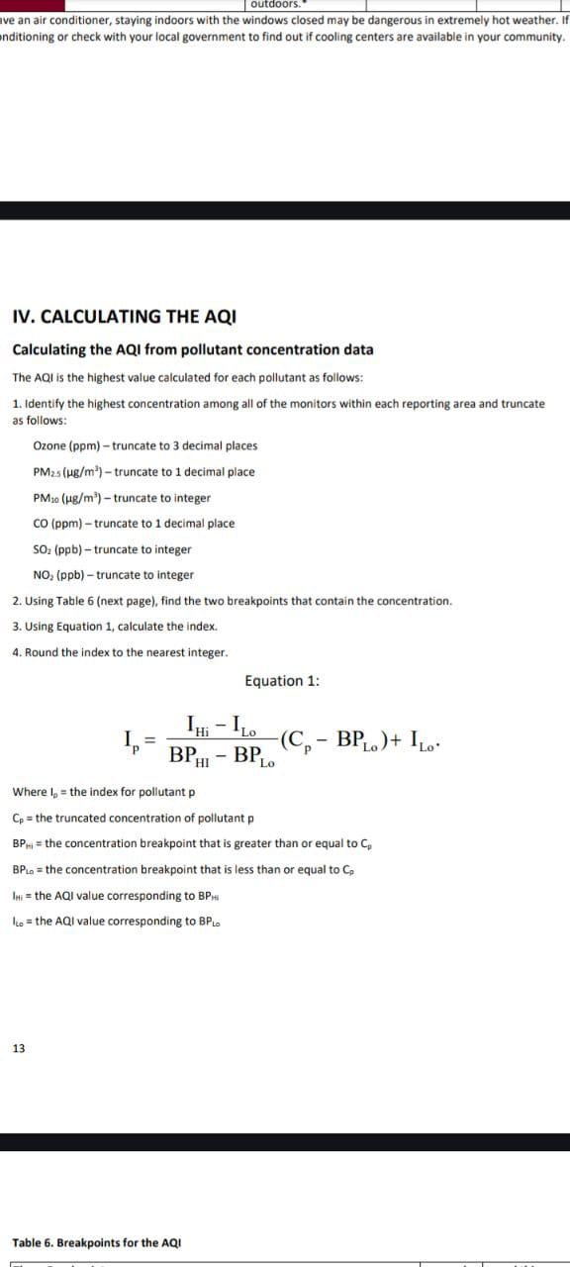

Slide 9
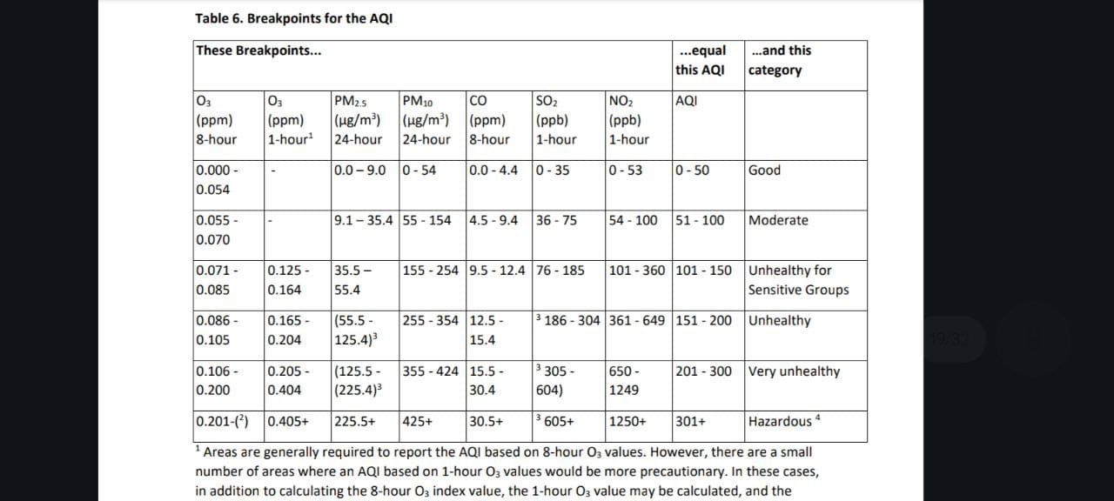

Slide 10
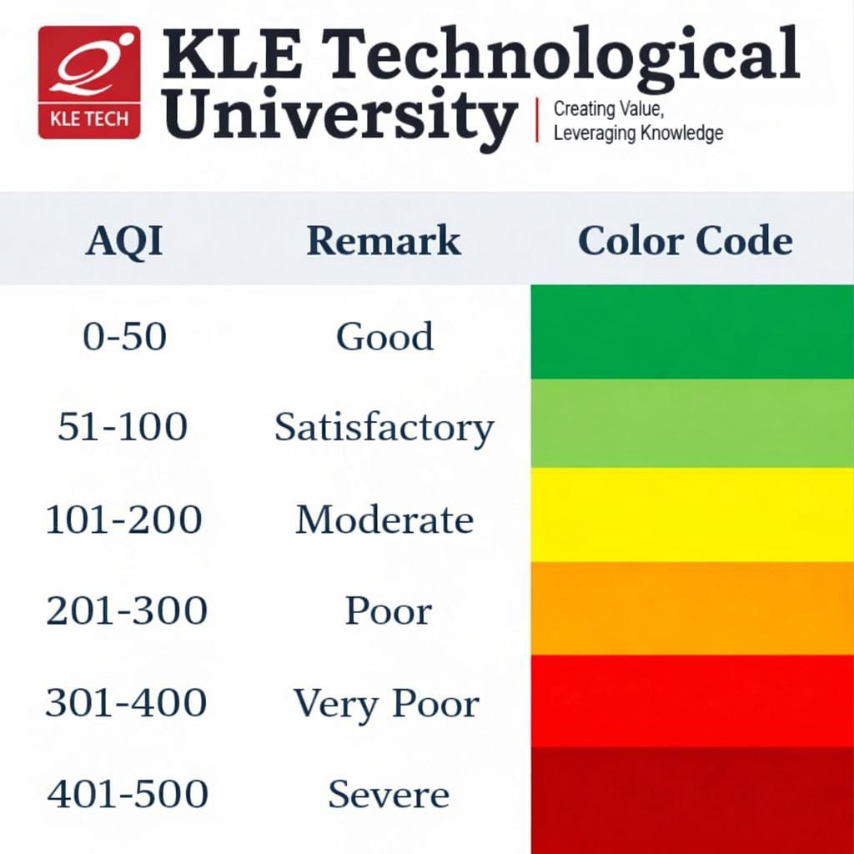

Slide 11
SDG involved :
SDG 3 : Good Health And Wellbeing
Target 3.9
By 2030, substantially reduce the number of deaths and illnesses from hazardous chemicals and air, water and soil pollution and contamination
Indicator 3.9.1 : Mortality rate attributed to household and ambient air pollution
Target 3.d
Strengthen the capacity of all countries, in particular developing countries, for early warning, risk reduction and management of national and global health risks
Indicator 3.d.1: International Health Regulations (IHR) capacity and health emergency preparedness

Slide 12
SENSOR SPECIFICATIONS

Slide 13
ESP32 S3 (N8R8) :
- is a single chip Wifi + bluetooth microcontroller
- dual core CPU
- wireless cconnection : 2.4GHz wifi
- upto 512KB internal SRAM
- external flash memory (8MB)
- 45 programmable GPIO pins
- interfaces supported : UART, I2C,etc..
- power characteristics : operating voltage - 3 to 3.6V
wifi current consumption: 20-30mA
active TX - 120 - 300mA
- programmable using: Arduino IDE, Micropython, etc..
APPLICATIONS-
-smart home automation
-IOT integration
-cloud connected devices, etc..

Slide 14
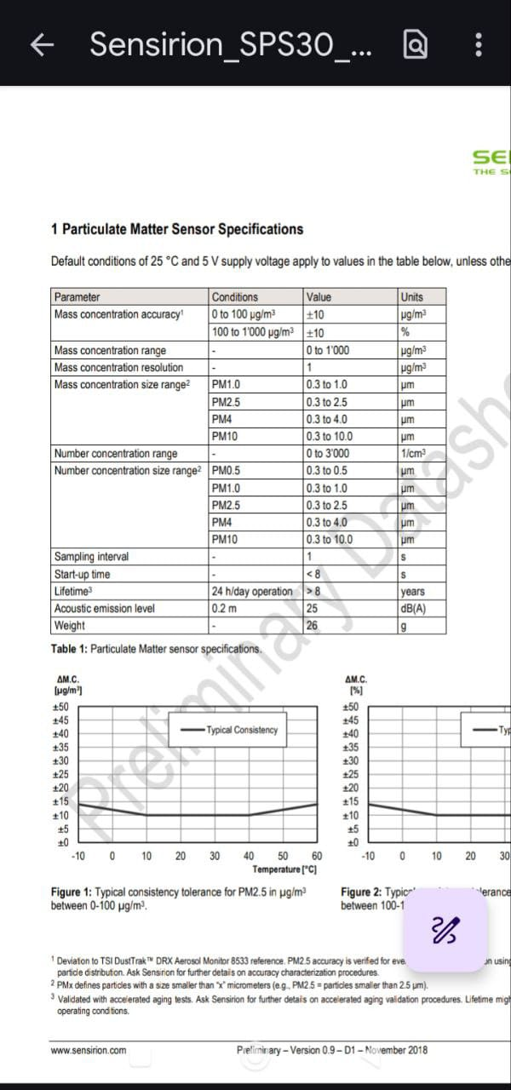
SPS 30 – PARTICULATE MATTER

Slide 15
SPS 30 – FEATURES
- Lifetime of more than 8 years
- Shows best performance when operated within
temperature range of 10 - 40 C and 20 – 80 % of humidity
- Accuracy increases with time
Time Behavior:
First 30 sec Sensor starts
First 10–15 min Elevated PM
First 1–2 hours Slowly settles
After 24 hours Stable baseline
First few readings are almost always higher
We can not judge accuracy immediately
If we compare:
We will almost always see:
Indoor PM > outdoor PM
Reasons:
Cooking
Fabric fibers
Skin particles
Dust resuspension
Human movement
Even a single person walking raises PM2.5 significantly.

Slide 16
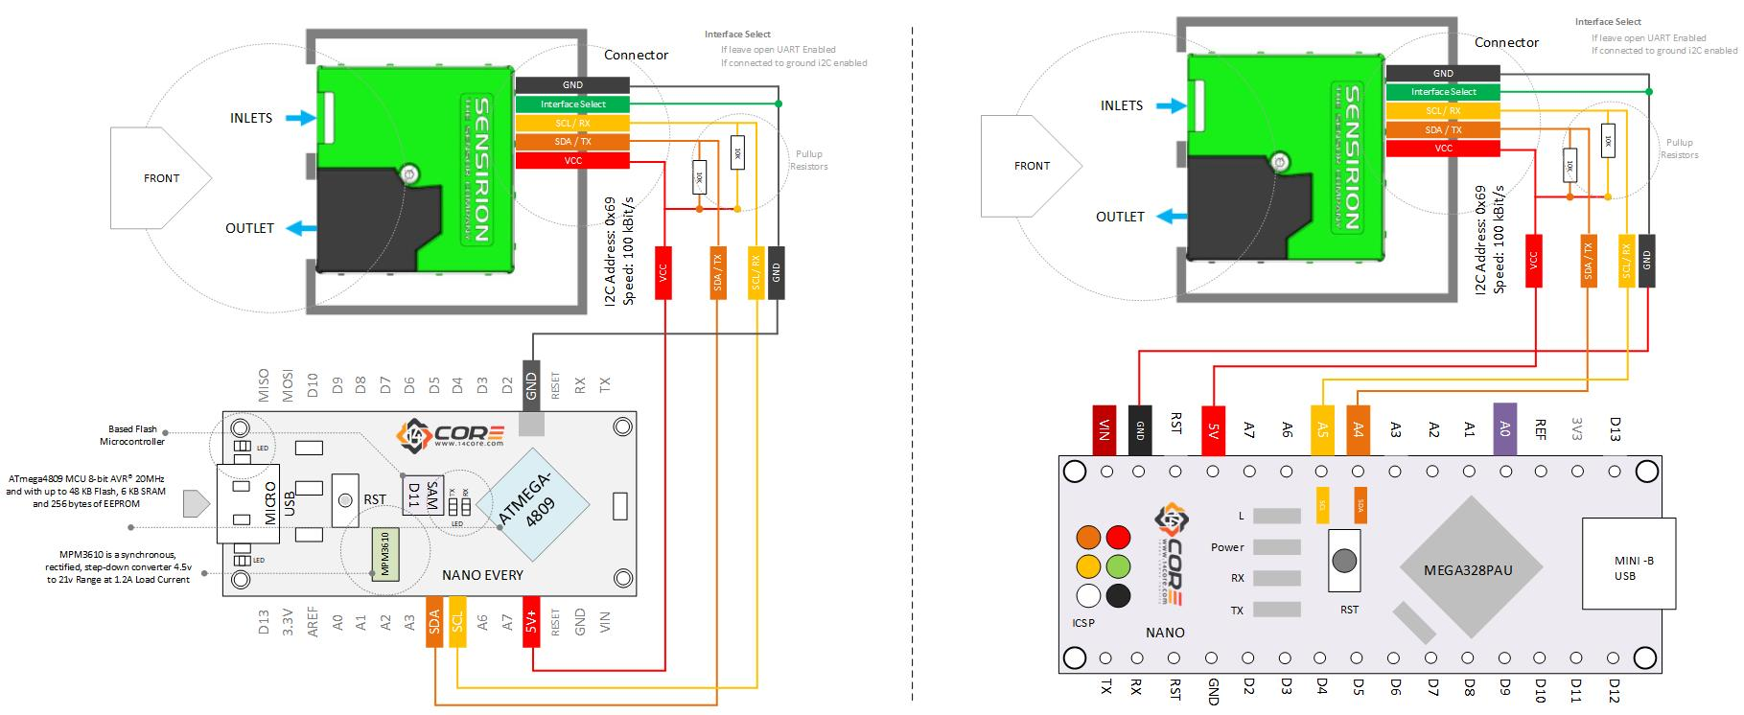

Slide 17
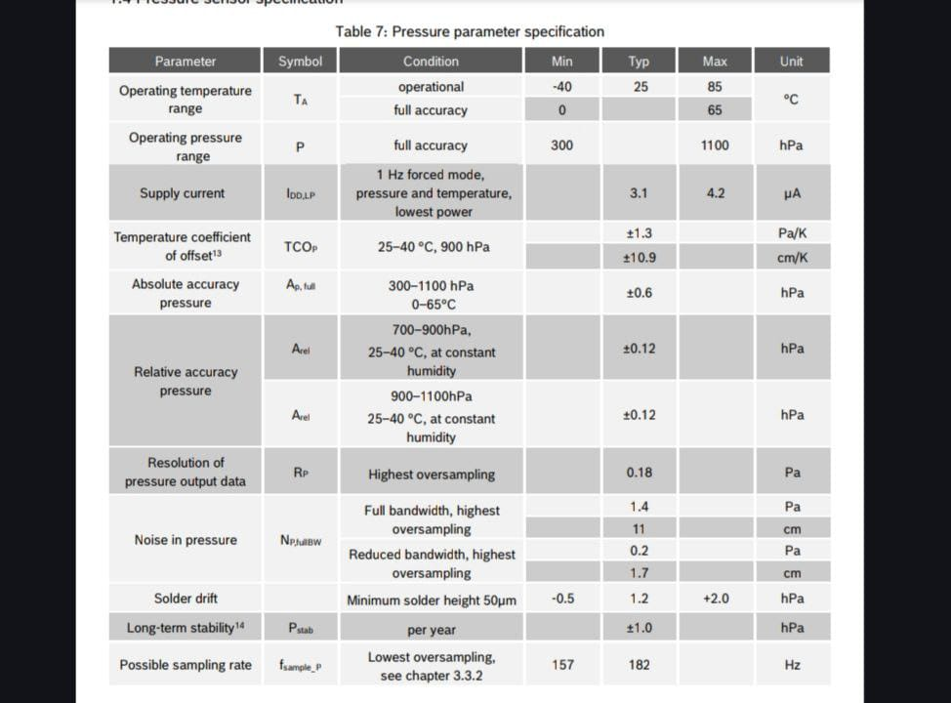
BME 680 - PRESSURE

Slide 18
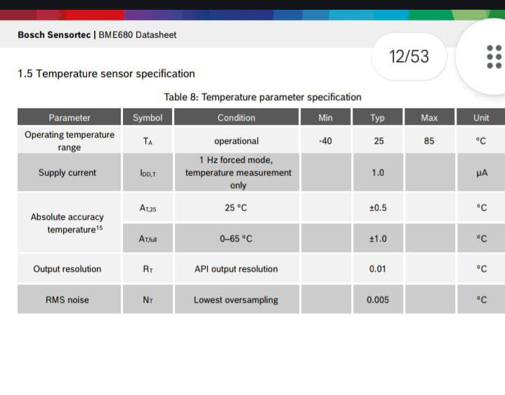
BME 680 - TEMPERATURE

Slide 19
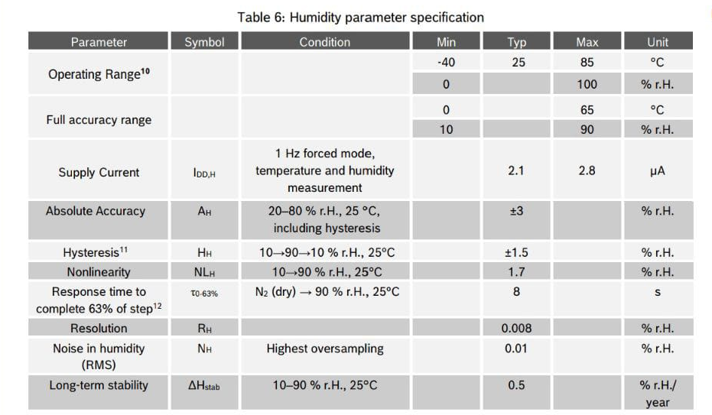
BME 680 - HUMUDITY

Slide 20
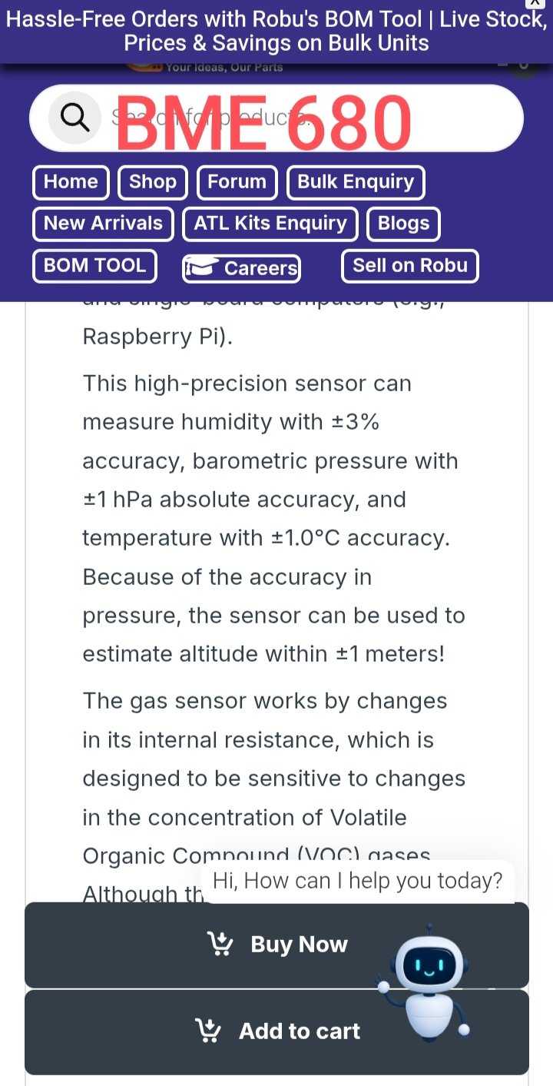

Slide 21
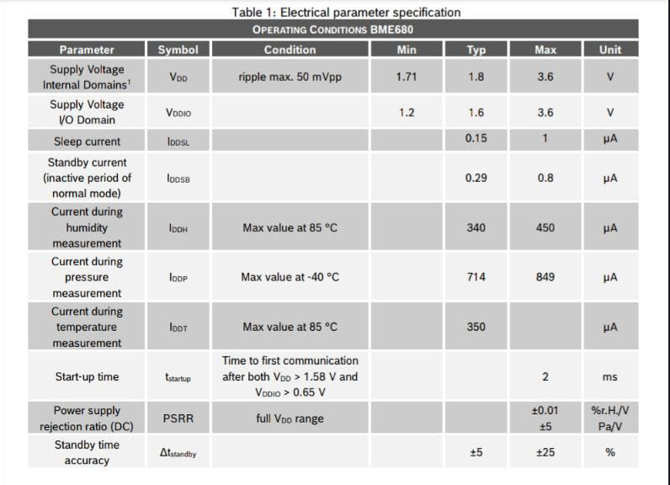

Slide 22
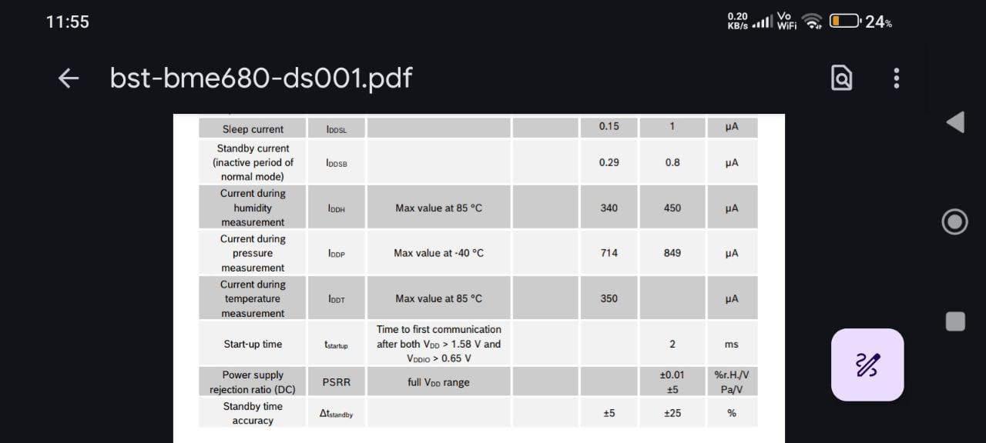

Slide 23
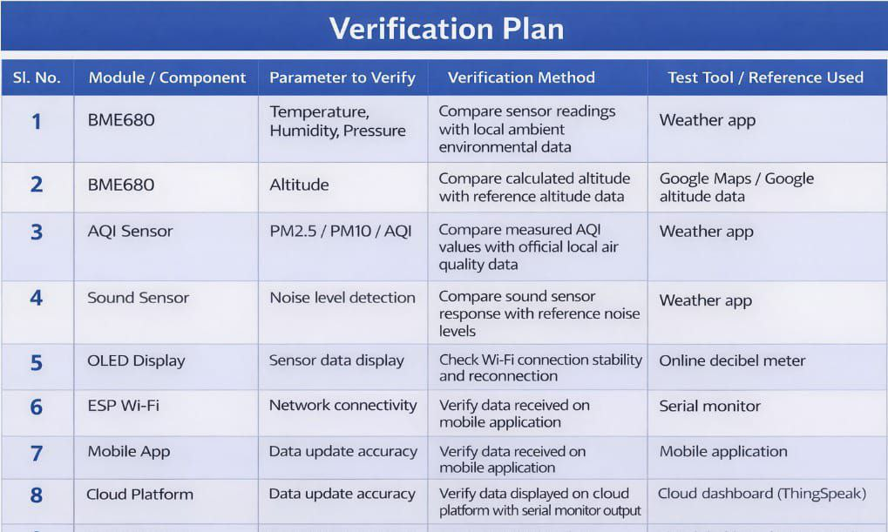

Slide 24
WHY WE CHOSE TO COMPARE SENSOR READINGS WITH MOBILE WEATHER APP OR GOOGLE DATA ??
-These aggregate data from government stations, satellites, and model predictions
-Represent area-level averages, not point measurements
-Our device is a point sensor, while mobile data is regional data.
So, we do not expect exact matching values.
-Easily accessible
-Widely accepted
-Uses standard AQI definitions
-Same reference used by general public
Limitations we should acknowledge Mobile weather AQI is:
-Area averaged
-Sometimes delayed
Our device:
-Measures real-time local air
-Can detect micro-environment differences (indoors, roadside, room-level)
Certified reference stations are expensive and not accessible for student-level prototypes.
Exact equality is not the goal; trend alignment and category correctness are the goal.

Slide 25
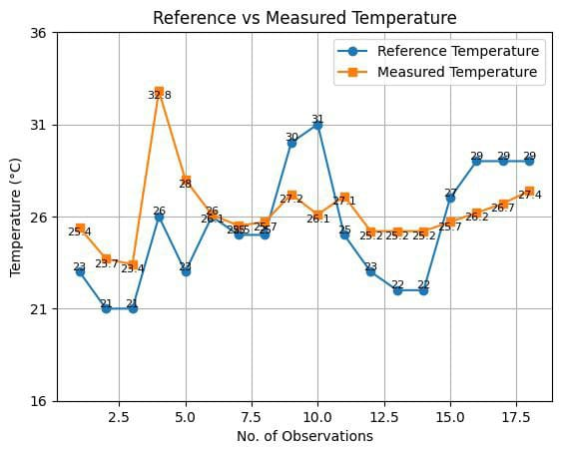
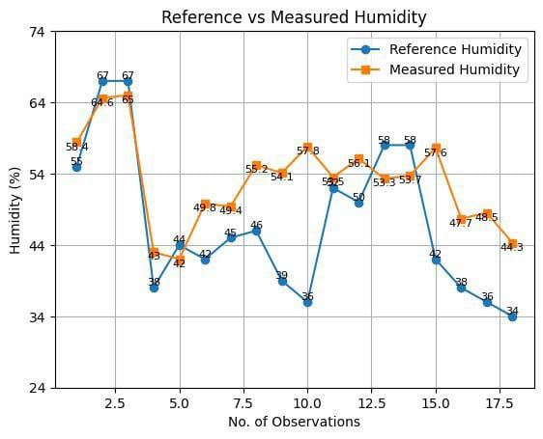
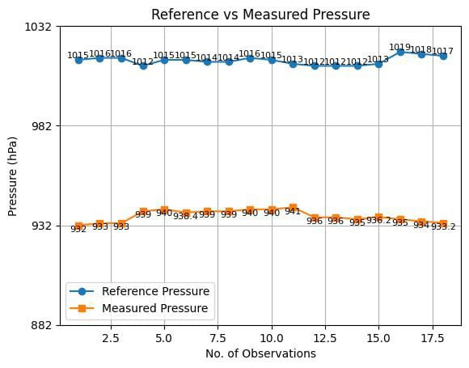
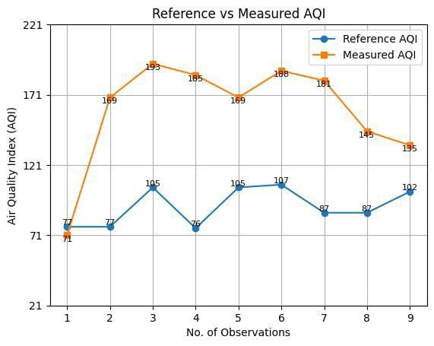
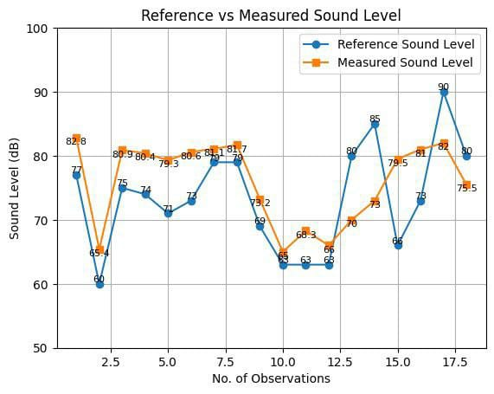
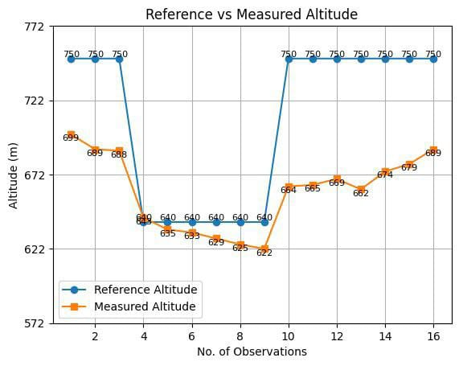
ACCURACY TEST OF SENSORS

Slide 26
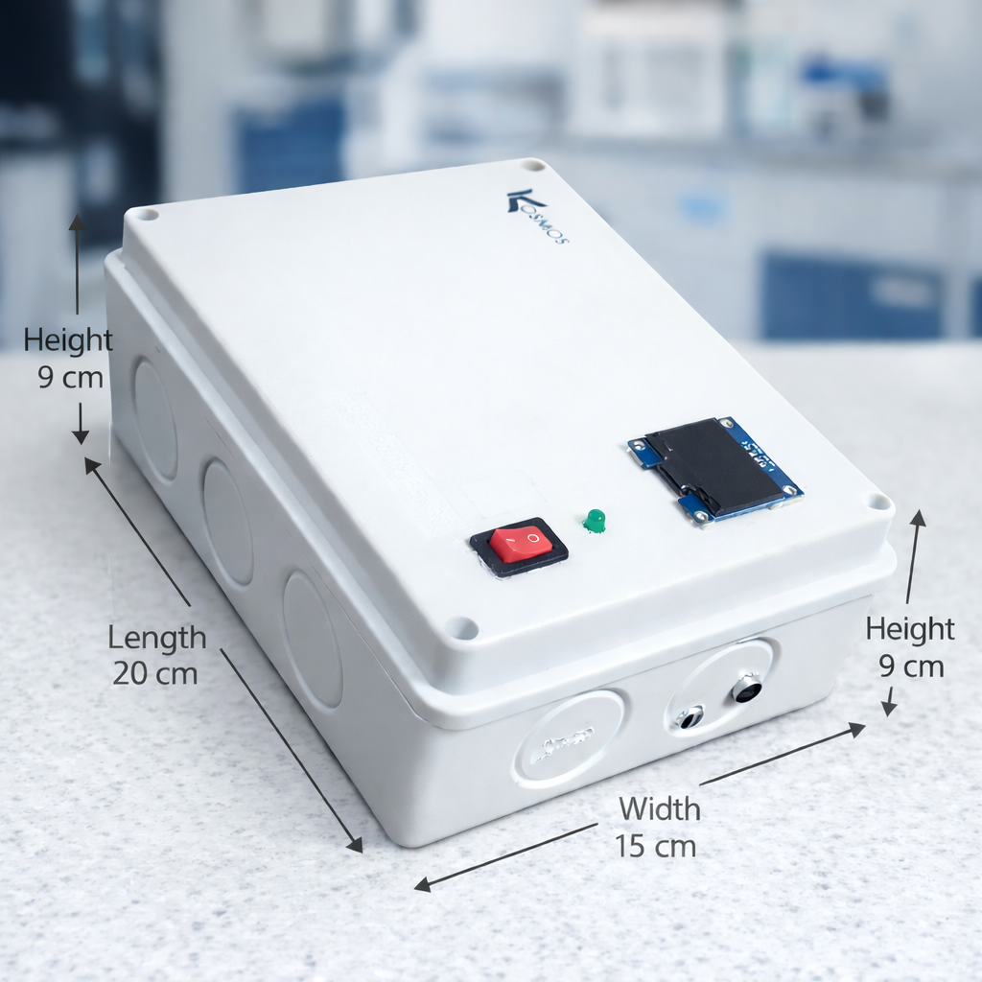
DIMENSIONS

Slide 27
Scope of improvements:
AQI calculation (only 2 parameters)
Notifications or alerts (not only inside app)
Rechargeable product
Larger display
LIMITATIONS –
Calculation using only 2 parameters (PM2.5 and PM10)
We may miss accuracy if :
- near heavy traffic – CO, NO2 peaks
- near refineries / power plants – SO2
- high photochemical smog – O3
BUT EVEN THEN –
-PM based AQI still reflects overall health risk
-It may underestimate peak gas exposure

Slide 28
LIMITATIONS –
Calculation using only 2 parameters (PM2.5 and PM10)
We may miss accuracy if :
- near heavy traffic – CO, NO2 peaks
- near refineries / power plants – SO2
- high photochemical smog – O3
BUT EVEN THEN –
-PM based AQI still reflects overall health risk
-It may underestimate peak gas exposure

Slide 29
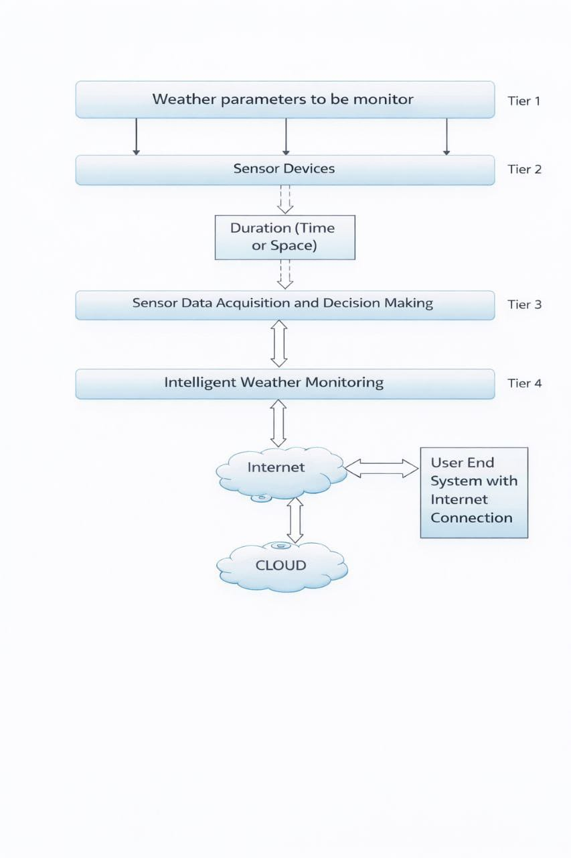
FLOW CHART

Slide 30
APPLICATIONS :
-Urban air quality monitoring
-Smart city environmental sensing
-Indoor air quality assistance
-Educational and research use
-Health and safety awareness systems

Slide 31
TOTAL COST OF THE DEVICE:
around 10,000/-

Slide 32
THANK YOU

